Slide 1
Preliminary Research Plan
Kevin Jose ACUNA CONDORI
02/09/2026

Slide 2
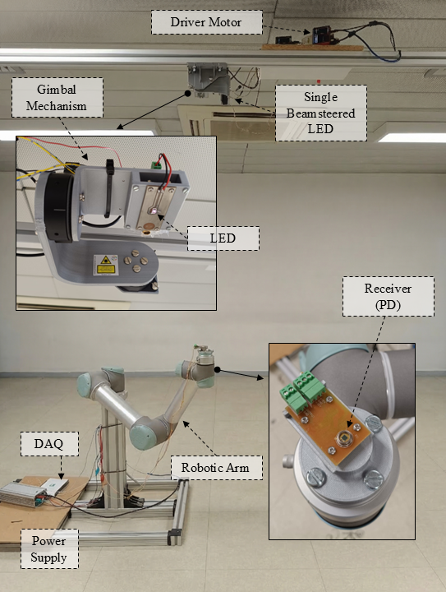
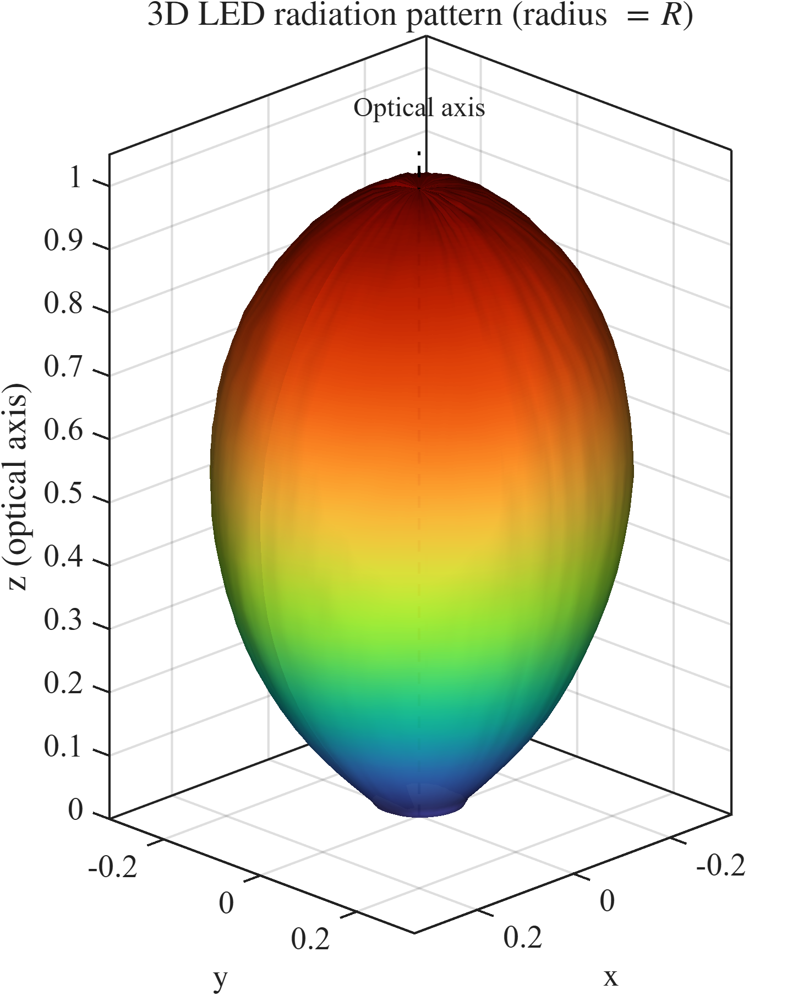
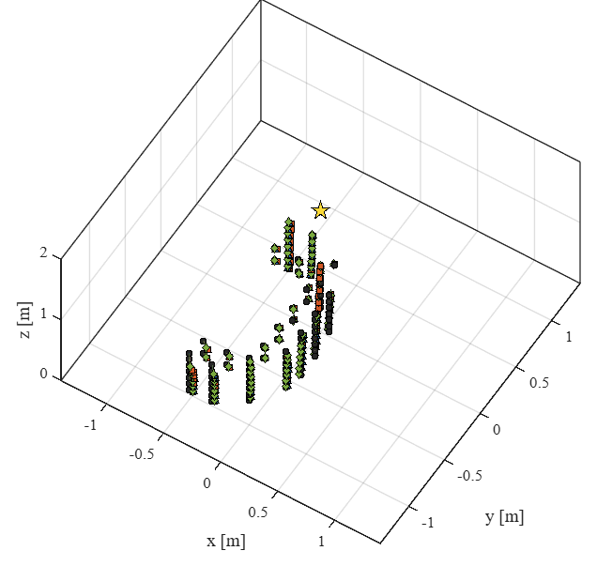
Background: Single Anchor OWP
2D
2025
Machine Learning
3D
2026
Model-based
Characterization
Theorical Analysis:
CRLB
Orientation-selection
Coverage

Slide 3
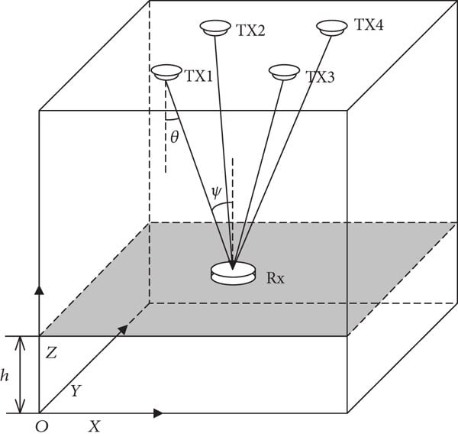
Motivation: Portability across installations
Installation A
Installation B
Optical Wireless Positioning system
What changes between sites?
- Geometry ( , anchor orientation, anchor number)
- Devices (LED pattern, PD response, Front-end)
- Environment (Reflections, room size, …)
layout

Slide 4
Motivation: First portability axis
Model-based approach
Machine Learning approach
Installation A
Layout A
Positioning Estimator A
Installation B
Layout B
Positioning Estimator B
Installation C
Layout C
Positioning Estimator C

Slide 5
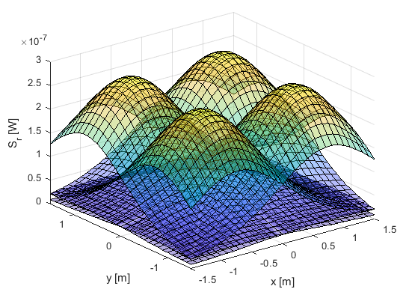


Proposal:
Positioning Estimator proposed
$[{RSS}_{i},p_{LED,i}$]
$$p_{PD,i}$$

Slide 6
Proposed Research Plan
1. Analysis
Characterise the OWP testbed
System model and Portability factors
Geometry / observability analysis
Generalization problem formulation
2. Simulation
Multi-layout simulation
Geometry-aware positioning
Seen vs. unseen layout evaluation
3. Initial Experimental Validation
Reference-layout validation
Test one or more unseen physical layouts
Initial assessment of the sim-to-real gap

Slide 7
Thanks

